Slide 1
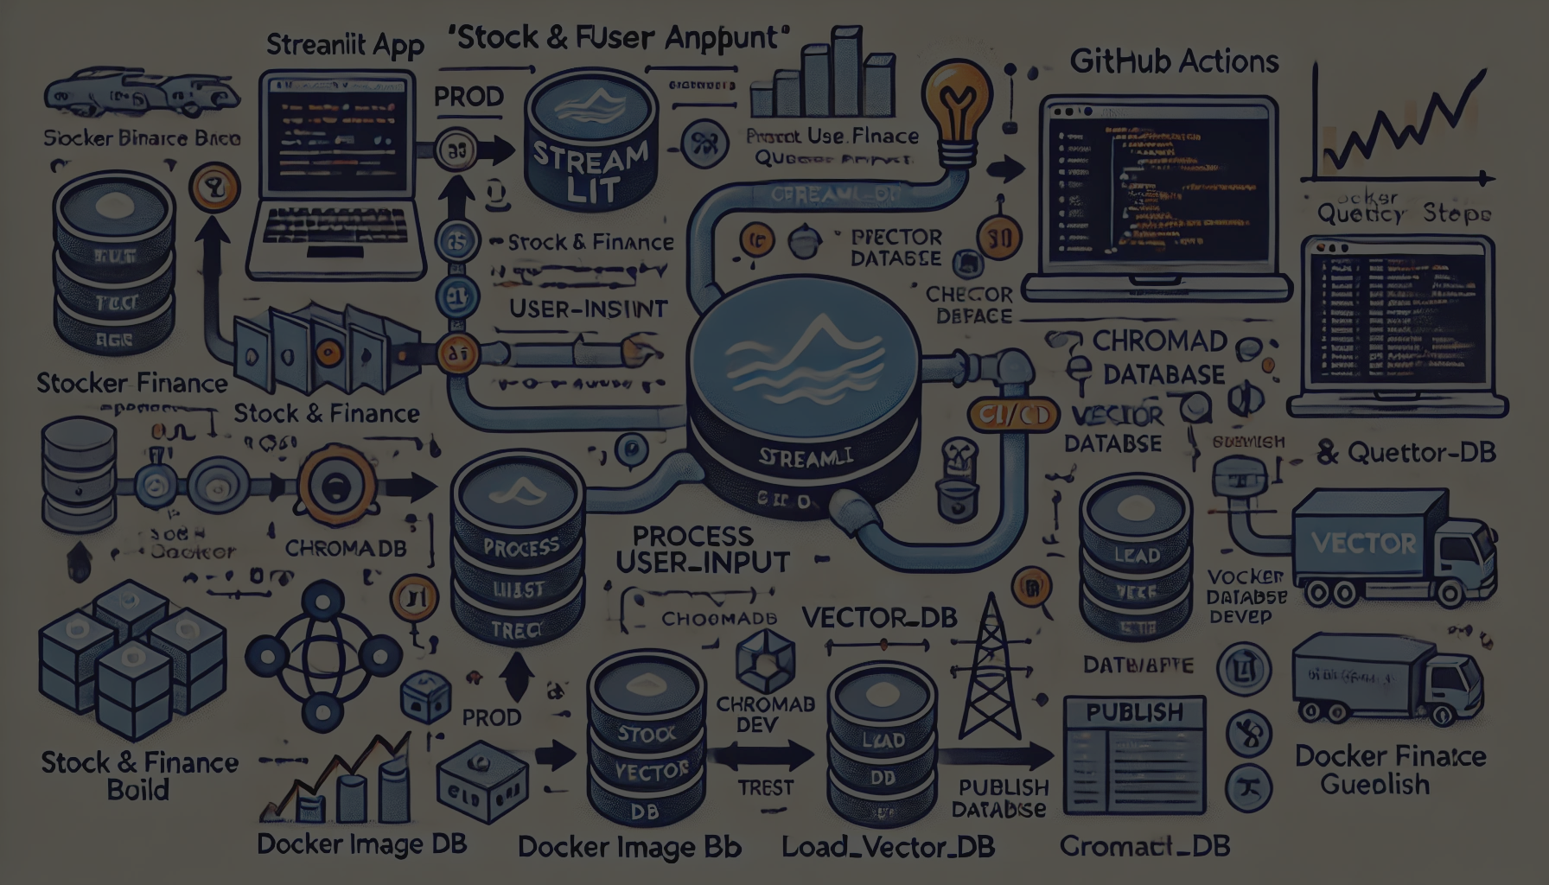


Stock Market Insights With AI Agent using Google GenAI & ChromaDB
code Breakdown and Workflow Explanation
Confidential
DD-MMM-YYYY
Kanukollu Goutham (804130) AND Bishweshwar Sukla(804133)
John Smith

Slide 2
Objective
Goal: Build an AI-powered stock market agent using Google Generative AI, LangChain, and ChromaDB. Our motivation behind it is the working professional who work tirelessly during the and don't get time to look into market, after coming back home it is essential for them to spend time with their family,so not to compromise with family time and investment we built something so they can quickly know what happen in the market
Capabilities: Fetch, store, and retrieve market data; process user questions; provide relevant financial insights.

Slide 3
Links
Github Link - https://github.com/bishweashwarsukla/project_agent
Docker Image Link -
https://hub.docker.com/r/kanukollugvt/flasktest-app

Slide 4
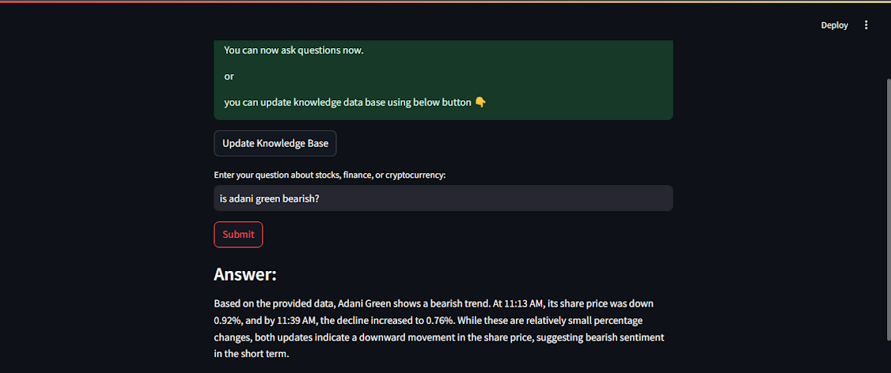
Sample output for our UI

Slide 5
Main Libraries Used
Google Generative AI: For embeddings and language model interactions.
LangChain & LangGraph: To create state-based workflows and manage prompt handling.
ChromaDB: Manages vector storage and retrieval.
Environment Configuration: dotenv for loading URLs and API keys from environment files.
Streamlit
Github Actions

Slide 6
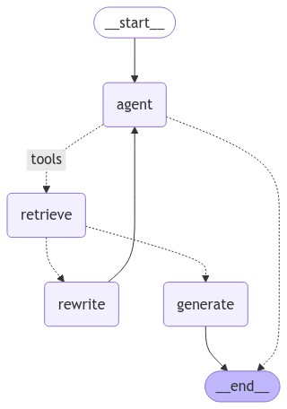
Agent overview

Slide 7
Workflow Overview
High-Level Flow:
Data Source & Loading: Load documents from finance news sites.
Vector Database Setup: Embed documents and store them in ChromaDB.
Retrieval & Processing: Query vector database for insights.
Response Generation: Leverage LLM to respond based on query results.

Slide 8
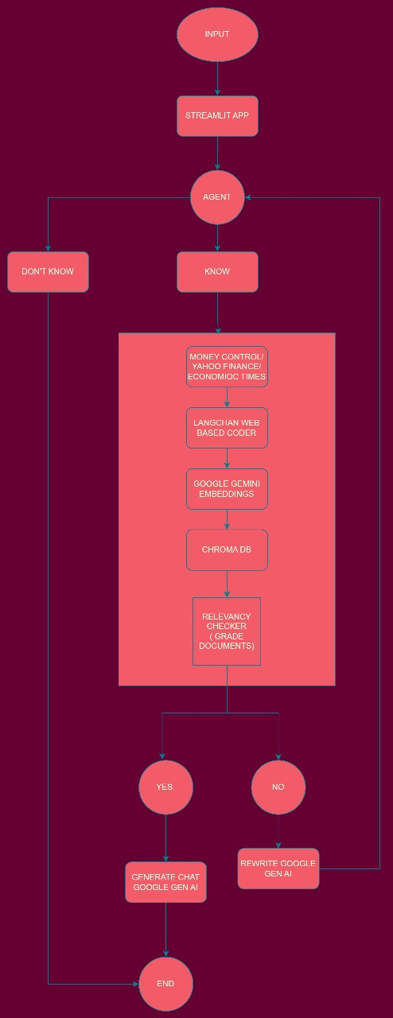

Slide 9
Module 1: Vector Database Loading & Setup
Function: load_vector_db()
Loads a prebuilt Chroma vector store for document retrieval.
Creates a retriever tool to answer queries related to stock and finance topics.
Function: build_vector_db()
Builds a new Chroma vector store from scratch.
Embeds documents using GoogleGenerativeAIEmbeddings.
Purpose: Store and retrieve financial news articles and analysis efficiently.

Slide 10
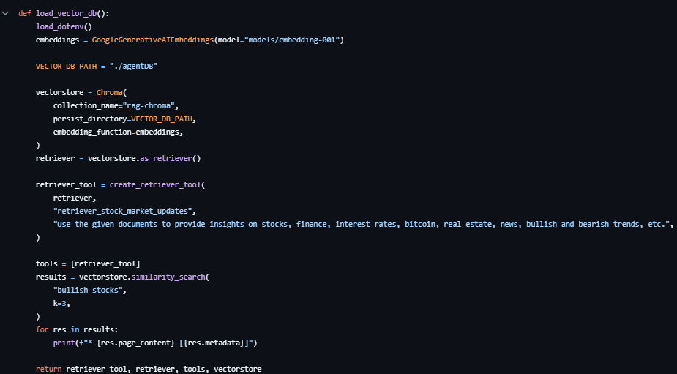

Slide 11
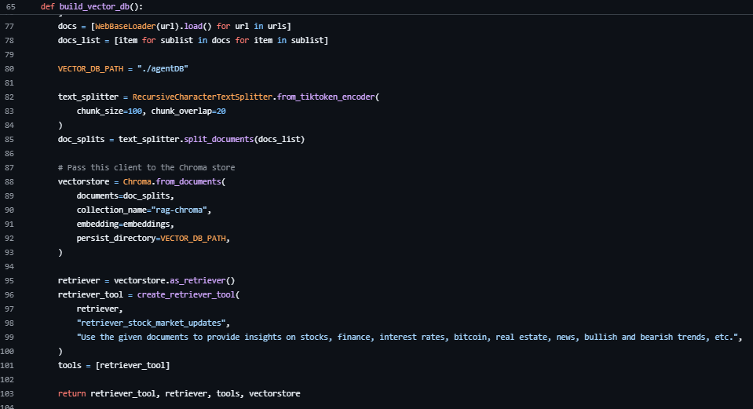

Slide 12
Module 2: Text Processing & Chunking
Text Splitter:
RecursiveCharacterTextSplitter: Chunks documents into smaller pieces to fit within token limits for embedding.
Chunk Size: Set to 100 characters with a 20-character overlap to improve context consistency across chunks

Slide 13
Module 3: Process User Input
Function: process_user_input()
Central function to handle user questions.
Loads embeddings and model; processes user input with the agent, retrieve, rewrite, and generate functions.
Uses ChatGoogleGenerativeAI model gemini-1.5-pro for question interpretation and response generation.

Slide 14
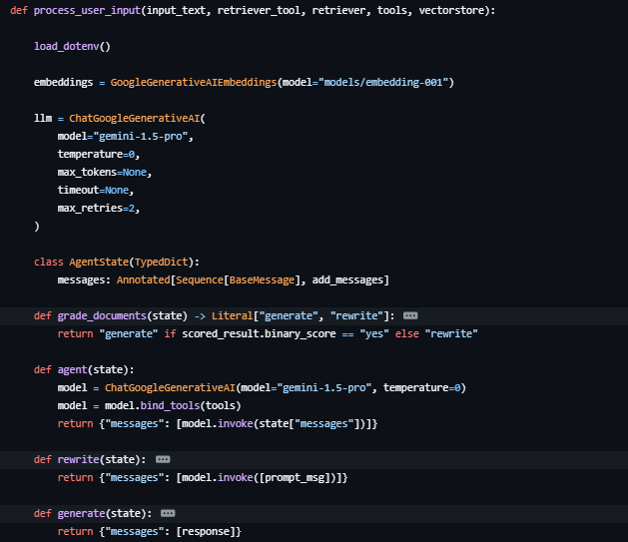

Slide 15
Core Agent Functions (Within process_user_input)
Agent Function:
Primary Logic: Manages interactions between the user input, vector database, and LLM.
Binds tools to interact with LangGraph workflow.
Document Grading (grade_documents):
Evaluates relevance of retrieved documents to the user’s question, generating or rewriting the response if needed.
Rewrite Function:
Purpose: Reformulates the user question if initial query fails to retrieve relevant data.
Generate Function:
Uses retrieved documents to generate a comprehensive answer for the user based on the relevant insights retrieved.

Slide 16
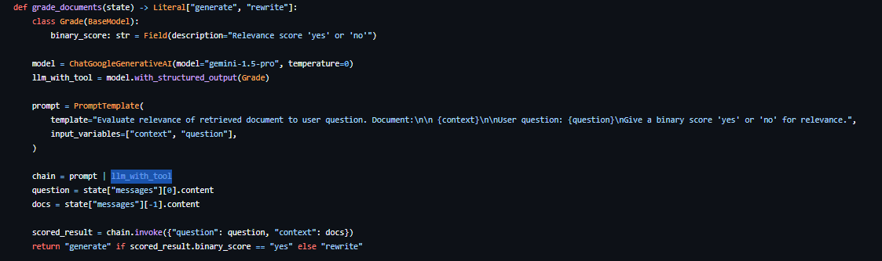

Slide 17
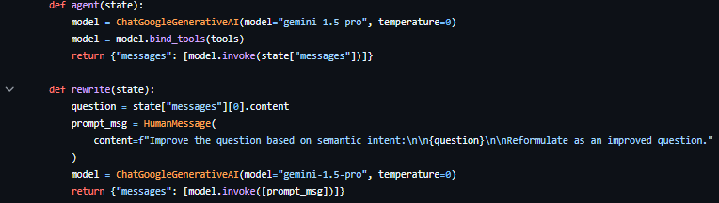

Slide 18
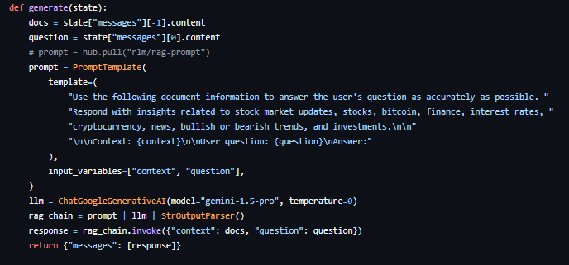

Slide 19
Workflow Management (Using LangGraph)
StateGraph Setup:
Node Definitions: Defines the agent, retrieve, rewrite, and generate nodes.
Conditional Transitions: Directs the workflow based on whether documents retrieved are relevant.
Edges: START, END, and conditional edges enable smooth transition through each step in the workflow.

Slide 20
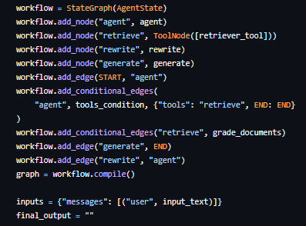

Slide 21
Environment Setup
dotenv Integration:
Purpose: Loads environment variables (like API keys and URLs).
Key environment variables include API access for Google GenAI and URLs for financial data sources.
“””
import os
from dotenv import load_dotenv
load_dotenv()
“””

Slide 22
Extensions & Improvements
Additional Features:
Add more financial data sources.
Implement error handling and retry mechanisms.
Performance Optimizations:
Explore model tuning options for ChatGoogleGenerativeAI.
Optimize document chunk sizes based on actual user input patterns.

Slide 23
Summary & Conclusion
Recap of Workflow: End-to-end process from document retrieval to LLM response generation.
Key Points:
Clear modularization allows for easy scaling.
Integrates LangGraph workflows to streamline and organize code structure

Slide 24
Web app

Slide 26
Streamlit Interface Overview
Purpose: Provides a user-friendly web interface to interact with the Stock & Finance Query Agent.
Key Components:
Interface to load or update the knowledge base.
Text input for user questions on stocks, finance, or cryptocurrency.
Real-time output display for AI-generated insights.

Slide 27
Streamlit Code Structure
Session State Initialization:
Uses st.session_state to store the state of vector database creation and ensure consistency across user actions.
Knowledge Base Loading:
Attempts to load an existing vector database using load_vector_db().
Provides user feedback on success or prompts to create a knowledge base if loading fails.

Slide 28
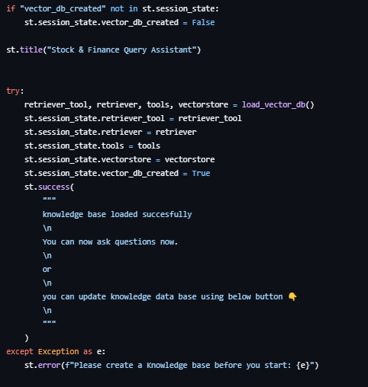

Slide 29
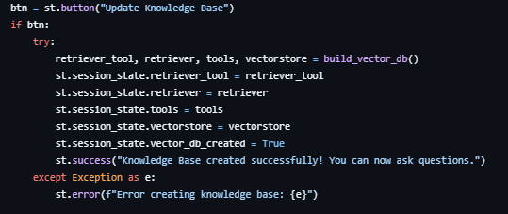
Knowledge Base Update Button
Button Interaction:
"Update Knowledge Base" button triggers build_vector_db().
On successful creation, stores the updated vector database in st.session_state.
Provides success/failure messages to inform the user.

Slide 30
Question Input & Answer Display
User Query Input:
Text input field for the user to ask questions.
Submit Button: Processes the input only if the knowledge base is loaded and displays the result.
Result Display:
Shows AI-generated answers directly under the input field.
Catches empty input to prevent processing without a question.

Slide 31
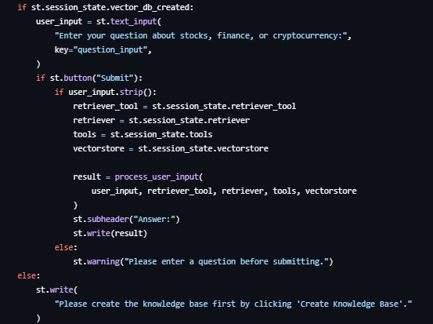

Slide 32
Error Handling & User Feedback
Error Messages:
Guides users if the knowledge base is not created or if no input is detected.
Displays success/failure messages after actions like database loading and updating.
Benefits:
Clear guidance for users unfamiliar with database creation and ensures smoother user interaction.

Slide 33
Mlops CI-CD

Slide 34
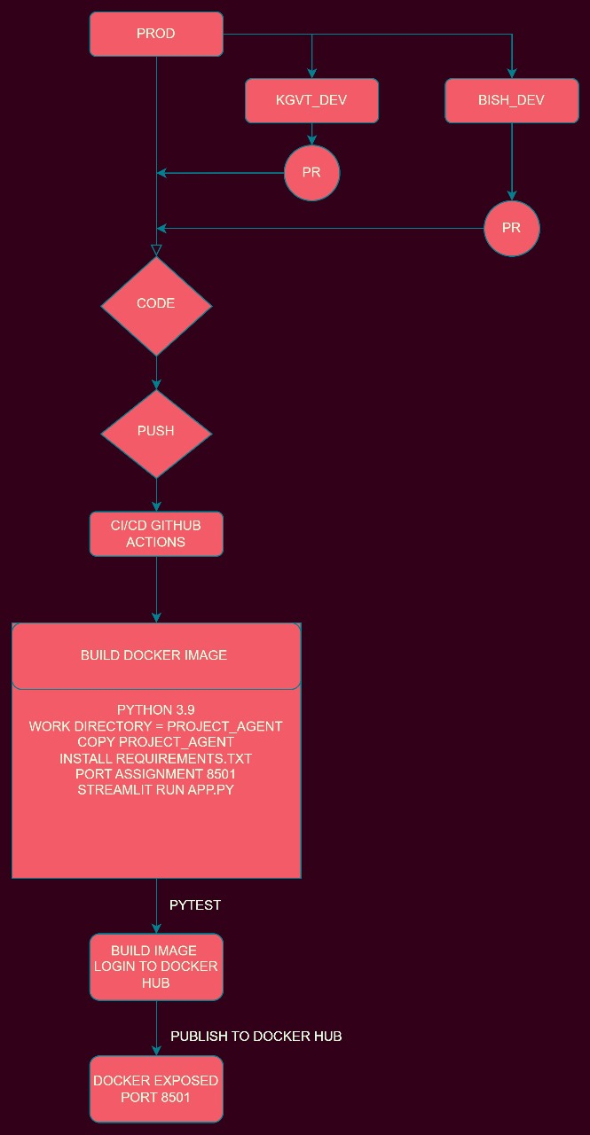

Slide 35
Overview of GitHub Actions CI/CD Workflow
Purpose: Automates the build, test, and deployment steps for the Dockerized application associated with the Streamlit app and vector database.
Key Components:
Trigger Conditions: Runs on pushes or pull requests to the prod, bish_dev, and kgvt_dev branches.
Job Stages:
Docker Build: Creates the Docker image.
Build and Test: Tests Python code to ensure stability.
Build and Publish: Publishes the Docker image to DockerHub on successful test completion.

Slide 36
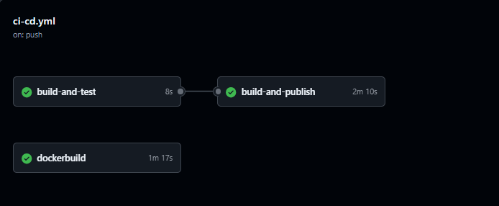

Slide 37
Workflow Structure: Jobs and Triggers
Docker Build Job:
Runs on ubuntu-latest.
Pulls the latest code and builds a Docker image with a timestamp tag.
Build and Test Job:
Sets up Python 3.9 environment, installs dependencies (pytest, python-dotenv), and runs tests using pytest to ensure functionality.

Slide 38
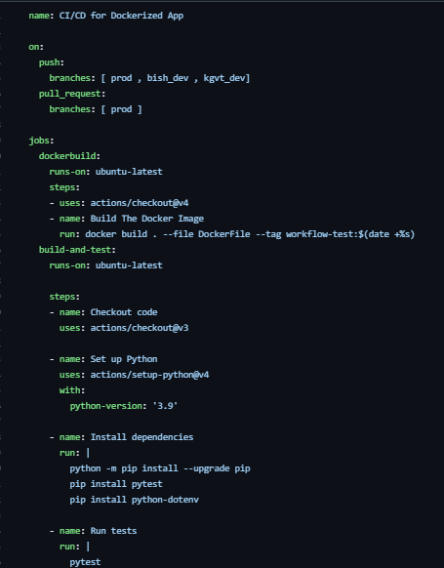

Slide 39
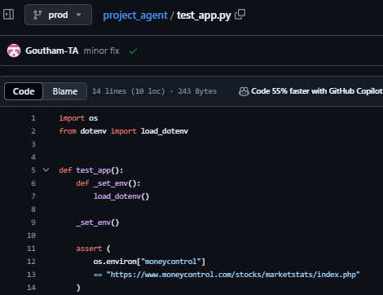

Slide 40
Docker Image Publish Job
Build and Publish Job:
Pre-requisite: Dependent on successful test completion (needs: build-and-test).
DockerHub Login: Uses DockerHub credentials from GitHub Secrets for secure login.
Image Build & Push: Builds and pushes the Docker image tagged latest to DockerHub.
Image Digest: Outputs the digest for traceability.

Slide 41
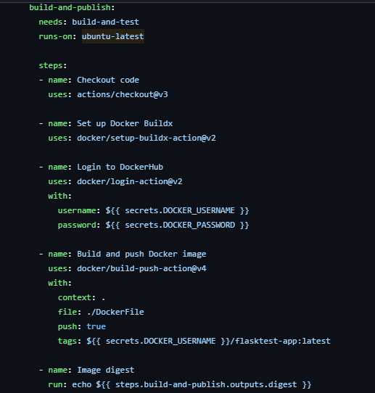

Slide 42
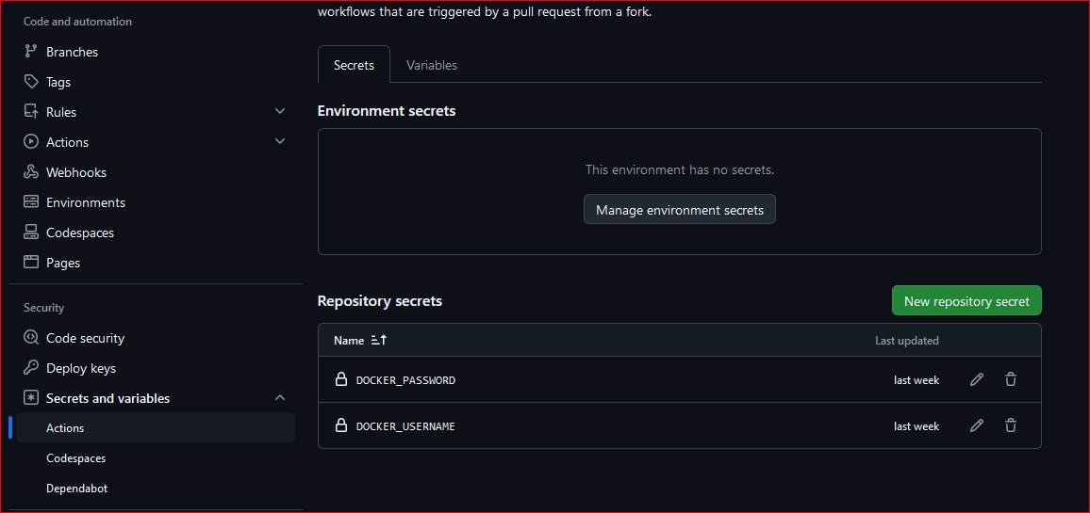

Slide 43
Integrating CI/CD with Streamlit App
Continuous Integration: Automates testing on every code change to maintain app stability.
Continuous Deployment: Automatically publishes Docker image, ensuring the latest version is readily available.
Benefits:
Eliminates manual deployment steps.
Guarantees consistency between local and deployed environments.
Provides quick feedback on code changes via automated tests.

Slide 44
Complete Workflow Overview
Combined Workflow:
Vector Database Processing and Streamlit App serve as the application.
CI/CD Pipeline ensures a stable and up-to-date Docker image is available for deployment.
Demo Flow:
Push or Pull Request triggers -> Docker Image Build -> Code Testing -> Docker Image Deployment.

Slide 45
Docker

Slide 46
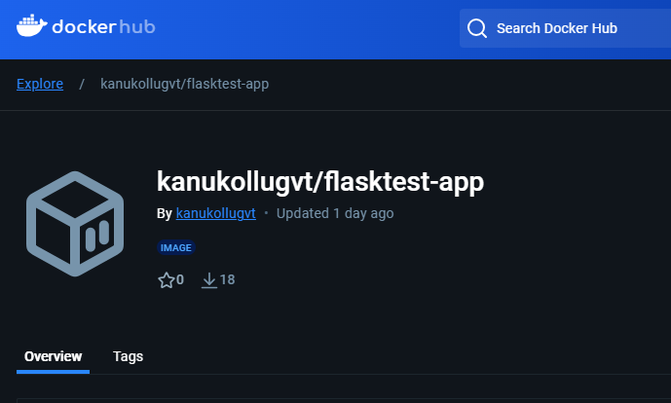

Slide 47
Dockerfile for Streamlit Application
Purpose: Defines the environment and dependencies for the Dockerized Streamlit app.
Key Points:
Uses an official, minimal Python image.
Installs dependencies and configures the container to run the app on startup.

Slide 48
Dockerfile Structure
Base Image:
FROM python:3.9-slim: Uses the official Python 3.9 slim image for efficiency.
Working Directory:
WORKDIR /project_agent: Sets /project_agent as the working directory inside the container.
Copy Project Files:
COPY . /project_agent: Copies all files from the current directory on the host to the container’s working directory.

Slide 49
Dependency Installation & Port Exposure
Install Requirements:
RUN pip3 install -r requirements.txt: Installs dependencies specified in requirements.txt.
Port Exposure:
EXPOSE 8501: Makes port 8501 available for the Streamlit app to serve requests.

Slide 50
Container Startup Command
Run Command:
CMD ["streamlit", "run", "app.py"]: Starts the Streamlit app when the container launches.
Explanation:
streamlit run app.py command initiates the app, allowing it to respond on the exposed port 8501.
Benefits:
This setup ensures consistency across deployments, as the same environment is recreated for each instance.

Slide 51
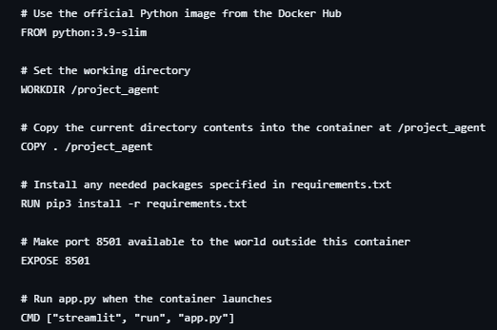

Slide 52
End-to-End Dockerized Workflow
From Development to Deployment:
The Dockerfile creates a standardized environment for running the Streamlit app.
GitHub Actions CI/CD workflow builds, tests, and deploys this Docker image.
Integrated Workflow:
Code -> Docker Image -> CI/CD Workflow -> Streamlit App Deployment
Advantages:
Streamlined deployment, environment consistency, and reduced setup overhead.

Slide 53
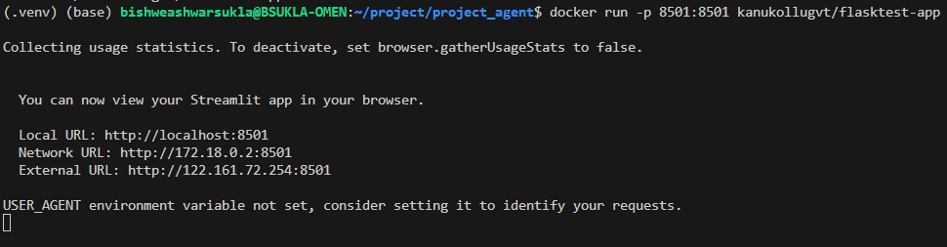

Slide 54
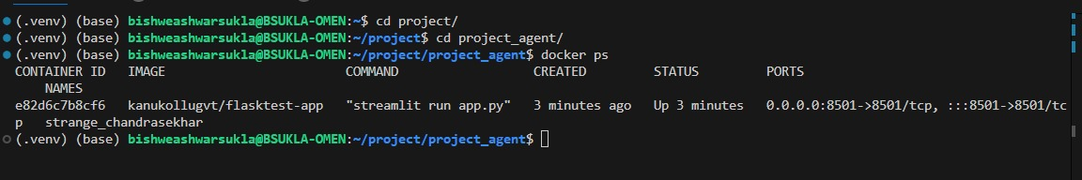

Slide 55
How to run
Pull docker image using docker pull kanukollugvt/flasktest-app
Run command streamlit run app.py ( if running in local)
Run command docker run -p 8501:8501 kanukollugvt/flasktest-app

Slide 56
Thank you
Kanukollu Goutham (804130) AND Bishweshwar Sukla(804133)

